Slide 1
Enhancing Dementia Diagnosis with ML
Blackwell Summer Scholars Program
B.S. in Statistics, Trustan Gabriel Price

Slide 2
Introduction
Background + Objectives

Slide 3
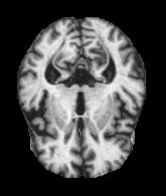
Background
dementia and alzheimers threatens the quality of life in people
early detection through research can help prevent dementia
my hypothesis and research question:
socioeconomic status, education level, and gender are strongly associated with the incidence of dementia.
How can machine learning algorithms improve the early detection and diagnosis of dementia, and what impact does this have on patient outcomes?

Slide 4
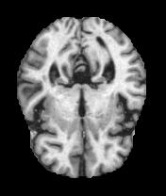
Objectives
provide advancement of medical research with machine learning
early detection of dementia in patients
supports early detection of Alzheimer's
allows for lifestyle changes and treatments that can delay the onset of severe symptoms
a greater goal of nationwide scalability
development of new treatments
decision support for medical professionals
personalized treatment plans

Slide 5
Literature Review
Summary of Previous Research

Slide 6
Summary of Previous Research
In 2016, Ortiz et al. utilized the Automated Anatomical Labeling (AAL) method
to distinguish between AD, MCI, and non-converting (NC) subjects
divided the brain into three-dimensional patches
In 2022, Subramoniam et al. developed a model using sliced MRI images as inputs for residual CNNs (ResNet-101)
In 2018, Islam and Zhang developed a CNN model that utilizes brain MRI data to detect AD
using 416 photos from the OASIS dataset
achieved an accuracy of 93%

Slide 7
Literature Review
In 2022, Alorf and Khan focused on classifying various stages of Alzheimer’s Disease
only able to achieve an average accuracy of 77.13% (Stacked Sparse Autoencoders ) and 84.03% (Brain Connectivity Convolutional Network)
In 2023, Kishore and Goel aimed to develop a DNN for diagnosing AD and categorizing its stages
used Fluorodeoxyglucose PET scans
differentiated between subjects with AD, stable MCI (sMCI), progressive MCI (pMCI), and CN individuals
achieved exceptional accuracy rates: 99.31% for CN versus AD, 99.88% for CN versus MCI, 99.54% for AD versus MCI, and 96.81% for pMCI versus sMCI.

Slide 8
Methods
Data Collection + Study Design + Data Analysis

Slide 9
Data Collection
Kaggle dataset that included:
Cross-Sectional Dataset
a snapshot of data at a single point in time
useful for identifying patterns and relationships between variables at one moment
Longitudinal Dataset
data collected over a period of time from the same subjects
valuable for studying changes and developments over time, especially in disease progression
Training and Test Set of MRI Images
split into four different classes
essential for teaching the model to recognize patterns and features

Slide 10
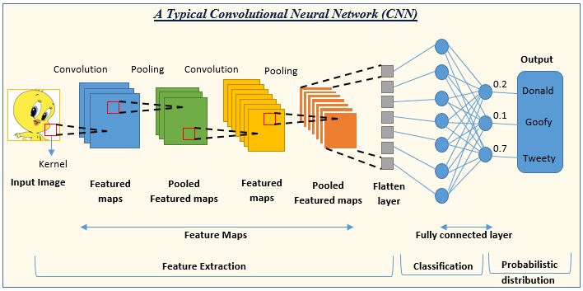
Study Design
For the different designs of my study, I developed:
Custom Convolutional Neural Network (CNN)
regression analysis model
classification analysis model
Convolutional Neural Network - Experimental
controlled environment
testing of hypotheses
Regression and Classification Analysis - Observational
working with pre-existing data without introducing any interventions or experimental conditions
identified correlations, patterns, and trends

Slide 11
Observational Data Analysis
Logistic Regression & K-Nearest Neighbor Classifier
tested different independent variables from the longitudinal study
used dementia column as a binary dependent variable (Demented: 1, NonDemented: 0)
found accuracy, precision, recall, F1, and confusion matrix
Correlations
women typically have higher brain volumes (r = 0.547)
people of higher socioeconomic status are more likely to be educated (r = 0.733)
nondemented brains are more likely to score higher on the mini mental state examination (r = 0.623)
the older you are, the less brain tissue to total intracranial volume you will have (r = 0.497)

Slide 12
Experimental Data Analysis
Convolutional Neural Network (CNN)
Architecture: Three convolutional blocks and one global average pooling layer.
Callbacks: Implemented LearningRateScheduler, EarlyStopping, etc.
Custom Scheduler: Developed a custom learning rate scheduler to optimize training.
Model Evaluation: Monitored Precision, Recall, and BinaryAccuracy metrics during training.

Slide 13
Results
Accuracy + Classification Reports + Confusion Matrices

Slide 14
Logistic Regression Performance
Classification Report:
Accuracy = 0.8646
Independent Variables:
MMSE: Mini-Mental State Examination
nWBV: Normalized Whole Brain Volume
ASF: Atlas Scaling Factor
SES: Socioeconomic Status
Dependent Variable:
Demented: 1, NonDemented: 0
Class | Precision | Recall | F1-Score | Support
0 | 0.85 | 0.93 | 0.89 | 57
1 | 0.88 | 0.77 | 0.82 | 39
Confusion Matrix:
Actual/Predicted | 0 | 1
0 | 53 (TN) | 4 (FP)
1 | 9 (FN) | 30 (TP)

Slide 15
K-Nearest Neighbor Performance
Classification Report:
Accuracy = 0.875
Independent Variables:
MMSE: Mini-Mental State Examination
nWBV: Normalized Whole Brain Volume
ASF: Atlas Scaling Factor
EDUC: Education Level
Dependent Variable:
Demented: 1, NonDemented: 0
Class | Precision | Recall | F1-Score | Support
0 | 0.84 | 0.97 | 0.90 | 37
1 | 0.95 | 0.74 | 0.83 | 27
Confusion Matrix:
Actual/Predicted | 0 | 1
0 | 36 (TN) | 1 (FP)
1 | 7 (FN) | 20 (TP)

Slide 16
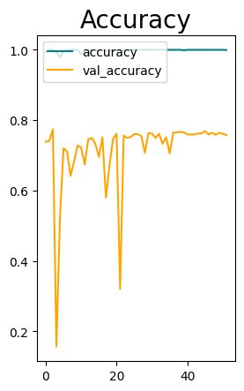
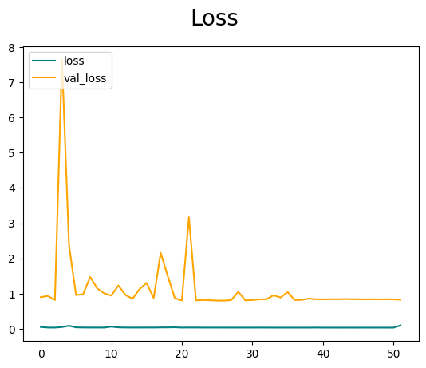
Convolutional Neural Network (CNN)
Model + Validation Accuracy
Model Performance:
Accuracy = 0.7483
Loss: 0.9557
Test Set Results:
Test Accuracy: 0.7404221892356873
Test Loss: 0.9755898714065552
Model + Validation Loss

Slide 17
Convolutional Neural Network (CNN)
Classification Report:
 | Precision | Recall | F1-Score | Support
MildDemented | 0.17 | 0.18 | 0.17 | 179
ModerateDemented | 0.00 | 0.00 | 0.00 | 12
NonDemented | 0.49 | 0.47 | 0.48 | 640
VeryMildDemented | 0.34 | 0.35 | 0.35 | 448

Slide 18
Convolutional Neural Network (CNN)
Confusion Matrix:
Actual/Predicted | MildDemented | ModerateDemented | NonDemented | VeryMildDemented | Support
MildDemented | 32 | 3 | 82 | 62 | 179
ModerateDemented | 1 | 0 | 7 | 4 | 12
NonDemented | 91 | 7 | 299 | 243 | 640
VeryMildDemented | 66 | 5 | 219 | 158 | 448
Predicted Support | 190 | 15 | 607 | 467 | 1279

Slide 19
Conclusion
Main Findings + Significance + Future Possibilities

Slide 20
Main Findings
the best tests of dementia in a patient are MMSE, nWBV, and ASF
the dataset you load your model with is the most important part of the study
the moderate demented class had a 0% precision, recall, and F1-Score
an imbalance dataset will lower the accuracy of the model
imperative to be able to analyze an MRI
cross and longitudinal studies alone are not accurate enough
CNN models with MRI’s are accurate enough to detect and/or classify dementia
AD-DL is currently available on a limited scale
high levels of memory are essential for more complex models.
requires high-spec computer chips or CPUs

Slide 21
Research Significance
Early Detection
automated analysis of MRI scans can significantly speed up the diagnostic process
can slow the progression of the disease, improve the quality of life, and provide better patient outcomes
Comprehensive Analysis
the research can help identify new biomarkers and risk factors associated with dementia
can detect subtle changes in brain structure and function that may be early indicators of dementia
Integration with Other Technologies
CNN models can be integrated with other healthcare technologies, such as electronic health records (EHRs) and telemedicine platforms

Slide 22
Future Possibilities
Classifying Stages of Alzheimer’s Using Advanced Neural Networks:
ResNet-101 or VGG16:
implementing advanced neural networks such as ResNet-101 or VGG16
could improve the accuracy and reliability of early detection and classification of Alzheimer’s stages
Exploring Deeper Symptoms of Dementia with Machine Learning:
Random Forest Classifier:
explore and classify deeper symptoms of dementia
can potentially yield higher accuracies in identifying and differentiating dementia symptoms
Correcting the Weights of My Classes
manually modify the weights assigned to each class in the model
ensure there is an equal number of samples across all classes

Slide 23
Thank You
Blackwell Summer Scholars Program
B.S. in Statistics, Trustan Gabriel Price

Slide 24
Works Cited
Journal Article:
Sorour, S. E., & et al. (2024). Classification of Alzheimer’s disease using MRI data based on deep learning techniques. Journal of King Saud University - Computer and Information Sciences. https://www.sciencedirect.com/science/article/pii/S1319157824000296#b24
Dataset:
Dubey, Sarvesh (2019). Alzheimer's Dataset ( 4 class of Images) [Data set]. Database: Open Database, Contents: © Original Authors https://www.kaggle.com/datasets/tourist55/alzheimers-dataset-4-class-of-images/data

